Slide 1

Breast Cancer Machine Learning Predictor
Mina Morcos
Santoosh R
Darrell COllison

Slide 2
Our Journey
April 28th
Search for Data Sources and topic to explore.
April 30th
Data cleanup.
May 2nd
Logistic modeling
May 5th
Neural network
May 7th
The Big Day!
Final adjustments, cleanup, and rehearsal.

Slide 3
Breast Cancer
Each year in the United States, about 245,000 cases of breast cancer are diagnosed in women and about 2,200 in men. About 41,000 women and 460 men in the U.S. die each year from breast cancer.
Our goal: Increase the accuracy of predicting whether a possible breast cancer tumor was malignant or benign by analyzing the preexisting data of tumor’s surface obtained from an MRI scan
BreastCancer.org for more information

Slide 4
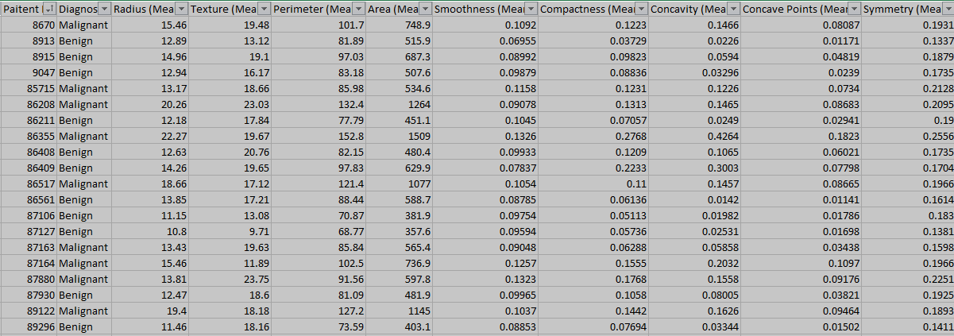
Kaggle Dataset
~500 rows x 30 columns

Slide 5
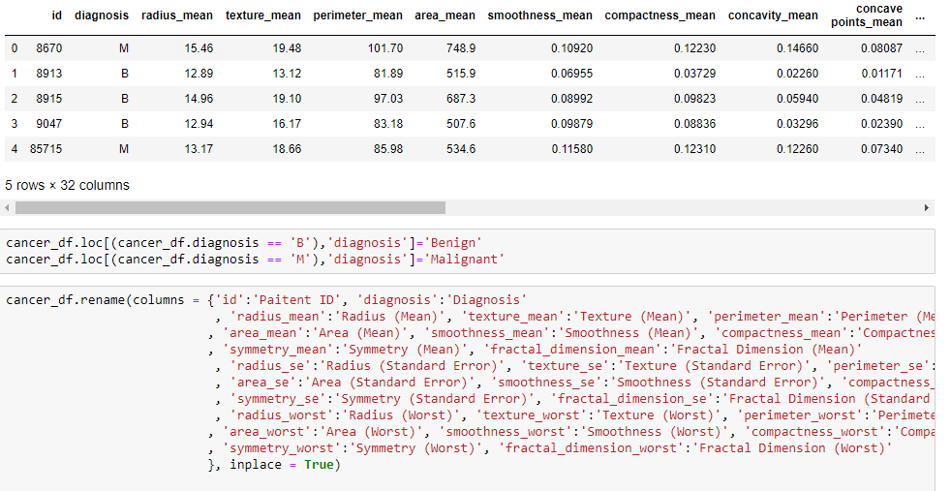
Data cleaning

Slide 6
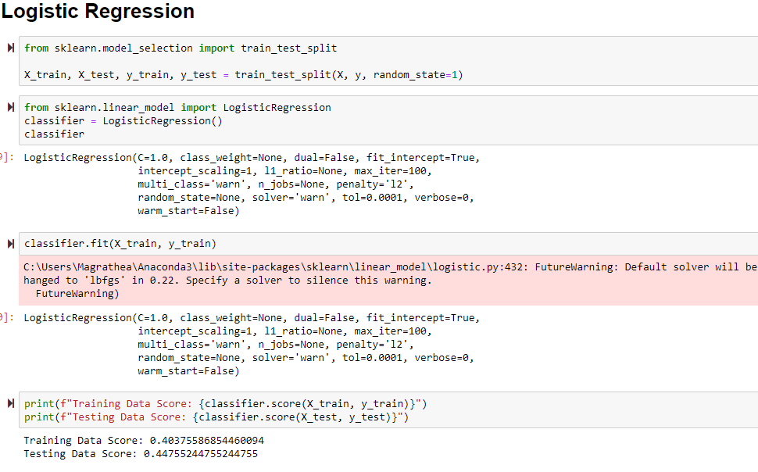
Logistic Model

Slide 7
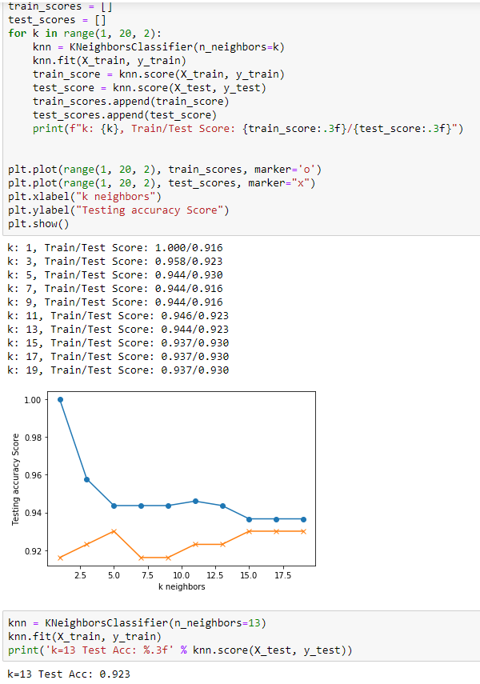
Test Scores

Slide 8
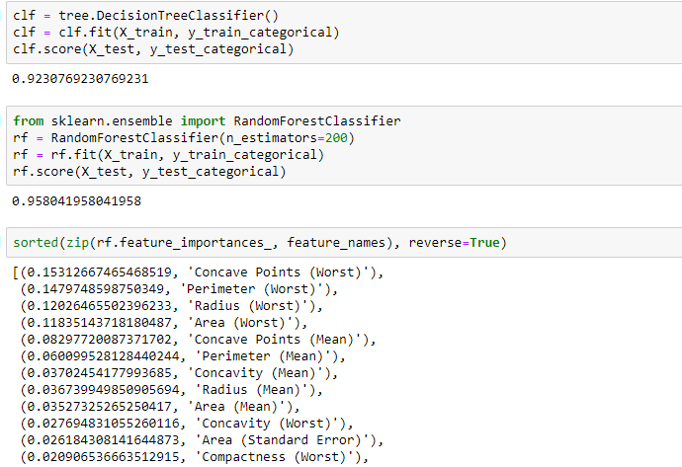
Random Forrest

Slide 9
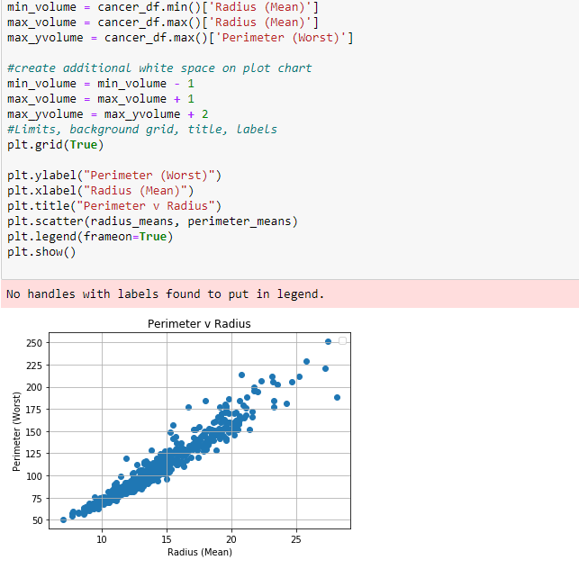
Plotting

Slide 10
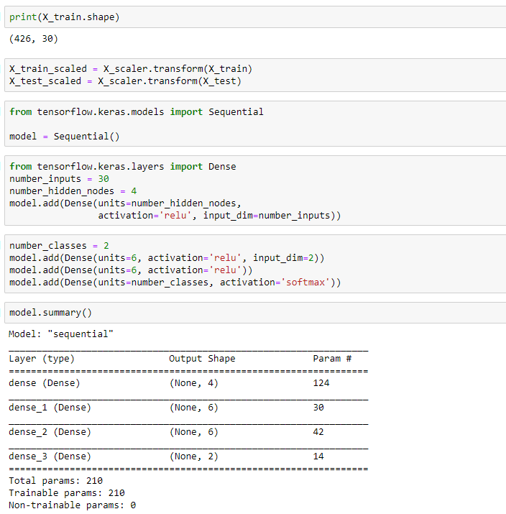
Neural Network

Slide 11
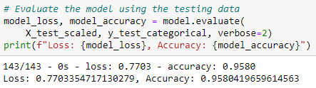
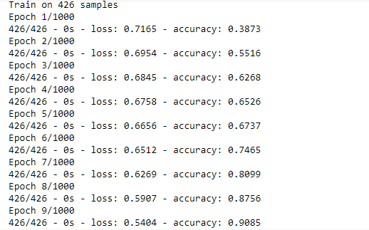
Testing Data

Slide 12
Thank you
Source:
https://www.kaggle.com/uciml/breast-cancer-wisconsin-data
Mina Morcos
Santoosh R
Darrell COllison

